Slide 1



Cadette Amaze Journey
Part 2

Slide 2
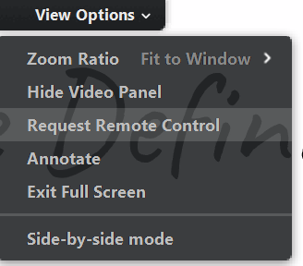
How will this Virtual Troop Meeting Work?
On bottom of your screen, there is a control panel. You should see a microphone, a video camera and a chat bubble.
When asked to speak, click on your microphone so it is green. Then everyone will be able to hear you.
If you have a webcam, clicking on it will let everyone else in the meeting see you too.
The Chat Log looks like a cartoon thought bubble. You can type questions or comments into the chat log and everyone will be able to see what you write!
          At the top of your screen is “View Options.” We will be using the “Annotate” option throughout this journey. Please only use this feature when asked.
          Use the “Escape” button to exit annotate and remember to clear the drawings when finished.
Notes:
And keep in mind…

Slide 3

Girl Scout Promise & Law
Girl Scout Promise
On my honor,
I will try, to serve God,
and my country, to help people at all times,
and to live by the Girl Scout Law.
Girl Scout Law
I will do my best,
to be honest and fair,
friendly and helpful,
considerate and caring,
courageous and strong,
responsible for what I say and do,
to respect myself and others,
respect authority,
use resources wisely,
make the world a better place and
be a sister to every Girl Scout.

Slide 4

Cadette Amaze Journey
This journey has three parts or awards.
Award 1. Interact – The ins and outs of people.
Award 2. Peacemaker – A toolkit
Award 3. Diplomat – Your Take Action Project
To finish the journey you will be required to complete a Take Action Project. The details will be discussed in Award 3 and additional materials will be provided in the post workshop email.

Slide 5
Remember - A word about journeys.
A journey cannot be a simple presentation.
We want you to be interactive and hear your voice. Sharing and learning from each other is the only way to learn from a journey.
Put your best Girl Scout foot forward and be brave. Have the confidence to share a little of yourself in this SAFE environment.
No one will bully you. No one will say that answer is stupid. And no one will think less of you if you stumble over the words.
We ALL promise to follow the Promise and Law and to act with Confidence, Courage and Character. We are sisters!

Slide 6
Our Team Agreement
Please read the agreement that we made in Part 1.
Notes:
Suggestions: Watch our body language (No eye rolling).
If we have a disagreement with someone in the group, we can..
If we have a difference of opinion, we can…
Capture the comments for use later.

Slide 7
Introductions
Be brave and unmute.
Tell us something you thought about since Part 1!
Notes:
We are going to break into smaller groups and use the breakout rooms to start a discussion.

Slide 8
Cliques
Sometimes when we are feeling pressured to do something we really don’t want to, it might be related to being in a clique. Can anyone think of an example?
What is a Clique? Please chat or shout out words, phrases, songs, movies, or feelings related to clique behavior (examples: left out, don’t belong, popular).

Slide 9
What is a Clique?
Some benefits of a clique are:
A sense of belonging.
Protection from another group.
A short term self esteem boost.
But what else do you get with a clique:
Strict behavior rules.
Loss of individuality.
Limited access to other people.
Have you ever been part of a group where you feel judged and controlled? Or have you been part of a group that is supportive but quickly morphs into something that restricts your social contacts and expects you to be someone that you are not? When that happens, you are in a clique.
Cliques have a lot of rules and they often deliberately include or exclude members. Most of the time the create a hostile environment for everyone around them.
Notes:
Are there times when you and some of your friends act like a clique?
What could you change about how you and your friends interact with others?
What do girls get from cliques?

Slide 10
What words, phrases, or feelings come to mind when you think about an inclusive circle of belonging or clique?
Notes:
Just see what they have to say.

Slide 11
Friendship
Take the pictures of your three friends and glue them in your journal.
Write how they are important to you and how they help you.
Share a special story about them that makes you happy.
Be ready to share at least one thing about a friend.

Slide 12
Are you a good friend?
Navigating Friendships
Got any good gossip?
Do you have something in common with someone else here today?
Just for kick starting thinking
Notes:
Don’t wait for answers. Its just to ignite thinking.

Slide 13


What really matters?
To your friends?
To you?
Write down five qualities that you think make a good friend.

Slide 14
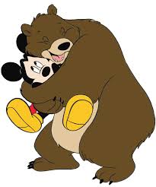
Optimistic
Neighborhood
Appearance
Race/Ethnicity
Intelligence
Popularity
Trustworthy
Loyalty
Rich
Caring
Accepting
Honesty
Attitude
Athletic
Similar
Fun to be with
Spiritual Beliefs
Courageous
Confident
Understands
Friendly
Notes:
Need some help? You never know who could be your friend unless you look beyond the first glance. Grizzly bear or teddy bear hugger?
Have girls use the annotation and circle the qualities that they wrote down, this will be a good way to see similarities, and then you can ask a few of them to explain ones that lots of people have circled and/or only one person circled.

Slide 15
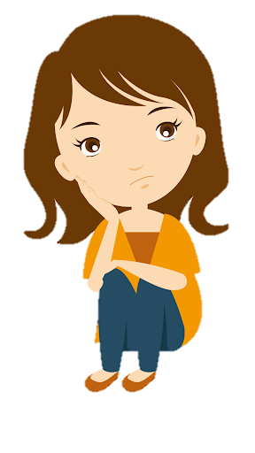
Did you ever feel pressured to do one thing when your gut tells you to do another? Is your gut normally right? This is a common obstacle in a friendship. Many times it can be a good thing to be challenged and pushed out of your comfort zone by friends. Then there is that time that just doesn't feel right. What should you do?
Ask yourself some questions:
  Will I get hurt, physically or emotionally?
  Will someone else get hurt?
  How will I feel afterwards?
Notes:
Have you ever ben challenged? Did you accept or say no?

Slide 16
Break Outs
Let’s break up into smaller groups and talk about one or two questions.
You will have about 3 minutes to discuss.
Choose one person that will speak for you when you return to the main group.

Slide 17
If I could excel at only one sport, it would be…
Beneath the Surface
Beneath the surface is a game where everyone wins.
Choose at least two questions and write them down in your journal.
Answer the questions.
Be prepared to share one answer.
Remember we ask everyone to share, but if you cannot it is OK.
Type something in the chat.
But please use your courage and unmute.
No one is judging.
Only a few other people know that I…
Before people get to know me, they assume I…
A time when my impression of someone was very wrong was…
My family made me proud when…
The first thing I hope other notice about me when we meet is…
Two words people use to describe me are…
My favorite song or book is…
Three qualities a leader should have are…
The nicest thing someone has ever done for me is…
If I could have only one artistic talent, it would be…
My biggest fear is…
The first thing I notice about someone new is…
The funniest thing that ever happened to me was…
Notes:
We are going to break up again for discussion and then we will share together. Have everyone write down 2 questions. When we get to the breakouts, pick a question and discuss. You have 3 minutes.
Beneath the surface:
1.Have you ever thought you knew something about someone else but found out you were wrong? Explain. 2. How do first impressions impact people?
3. What do you base your first impression on?
4. How accurate do you think your first impressions are when meeting people for the first time?
5. When have you had a completely wrong first impression of someone, and what changed your mind?
6. Can you think of situations when people had a wrong first impression of you?
What did you do to give an accurate impression of yourself?
7. What does it mean to: Be a friend first? And go beneath the surface?

Slide 18

Have you ever:
Let’s take a poll.
Notes:
Run the did you ever… poll. Then open discussion about the answers.

Slide 19
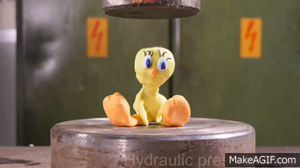
That’s called Peer Pressure
Take a stand! Right now, against peer pressure.
Pressure isn’t just what others do to you.
It’s also what you do to others. Build up your courage and make decisions that represent your true self and maybe even inspire others to do the same.
Peer pressure can be negative or positive. It can also be silent.
Imagine a classroom. There is a new teacher writing information on the board. Every time her back is to the class someone makes a strange, disruptive noise like a raspberry. Do you tell? Or are your afraid of social suicide?
Notes:
Ask for experiences.

Slide 20
See you tomorrow for part 3!
Tomorrow we will talk more about peer pressure and friendships as well as starting you on the road to your Take Action Project that you need to complete to finish the Amaze Journey. Start brainstorming what you can work to change. If you can’t think of something its OK. We will share ideas and maybe you will have a Eureka moment.
Thank you for sharing your time with us today!

